Slide 1

Artificial intelligence
Hossam Elsayed MohaMED Fakher
0 1 2 7 7 8 8 0 6 7 8
Gmail
GitHUB
Linkedin
Kaggle
S e s s i o n 5
Object Detection

Slide 2
Object Detection
Object detection is a phenomenon in computer vision.
The task of classifying and localizing multiple objects in an image.
Some of the objects detected include people, cars, chairs ……

Slide 3
Object Detection
• We all know about the image classification problem. Given an image, the Net finds out the class to which the image belongs.
• Localizing an object in a picture means predicting a bounding box around the object and can be expressed as a regression task.

Slide 4
Image Labeling Tool
Open-source image labeling tool like :
VGG Image
Annotator
LabelImg
OpenLabeler
ImgLab

Slide 5
Image Labeling Tool - Labelimg

Slide 6
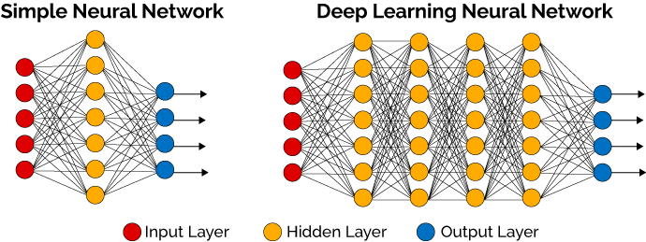
Object Detection - Example
raw image
416*416
image labeling
(C, X,Y, W, H)
model
• Each item should be a tuple of the form :
(images,
(class_labels, bounding_boxes) )
(C, X,Y, W, H)
image result

Slide 7
Object Detection - Example

Slide 8
Object Detection - Exp TL

Slide 9
Multiple Objects Detection
In general, object detectors have three (3) main components:
The backbone that extracts features from the given image.
2) The feature network that takes multiple levels of features from the backbone as input and outputs a list of fused features that represent salient characteristics of the image.
3) The final class/box network that uses the fused features to predict the class and location of each object.

Slide 10
Object Detection Algorithms
• YOLO (You Only Look Once) Version 1,2,3,4,5,6,7
• Single Shot Detector (SSD)
• Fast R-CNN
• Faster R-CNN
• Mask R-CNN

Slide 11
What Is Yolo?
• You Only Look Once (YOLO) is an algorithm that uses convolutional neural networks for object detection.
• It is one of the faster object detection algorithms out there.
• It is a very good choice when we need real-time detection, without loss of too much accuracy.

Slide 12
Yolo Steps

Slide 13
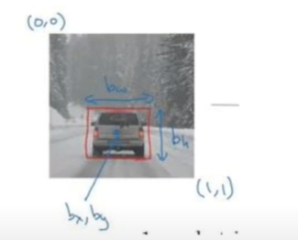
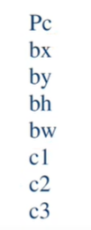
Yolo Steps

Slide 14
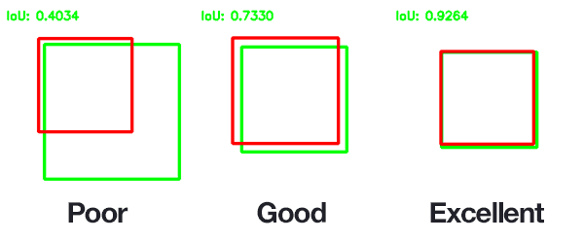
Intersection Over Union (IOU)
It describes how boxes overlap.
Each grid cell is responsible for predicting the bounding boxes and their confidence scores. The IOU is equal to 1 if the predicted bounding box is the same as the real box. This mechanism eliminates bounding boxes that are not equal to the real box.

Slide 15
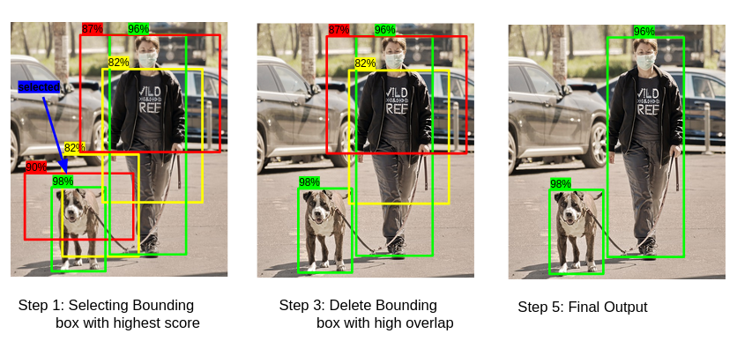
Non-Maximal Suppression
Non-max suppression is the final step of these object detection algorithms and is used to select the most appropriate bounding box for the object.

Slide 16
Yolo Steps
Backbone
refers to the feature-extraction architecture. Tiny YOLO has only 9 convolutional layers, so it’s less accurate but faster and better suited for mobile and embedded projects.
Darknet53 ( The backbone used in YOLOV3) has 53 convolutional layers, so it’s more accurate but slower.
In YOLOv4, backbones can be VGG, ResNet, SpineNet, EfficientNet, ResNeXt, or Darknet53.

Slide 17
Yolo Steps
Neck
additional layers between the backbone and the head (dense prediction block), its purpose is to add extra information in the layers.( Feature Pyramid Networks, Path Aggregation Network ).
Head
The head block is the part used to: locate bounding boxes and classify what’s inside each box.

Slide 18
YOLOV5
• YOLOv5 is smaller and generally easier to use in production.
Given it is natively implemented in PyTorch (rather than Darknet), modifying the architecture and exporting to many deploy environments is straightforward.
• YOLOv5s is about 88% smaller than big-YOLOv4 (27 MB vs 244 MB).

Slide 19
YOLOV5

Slide 20
How To Evaluate Object Detection Model?
• The MSE often works fairly well as a cost function to train the model, but it is not a great metric to evaluate how well the model can predict bounding boxes.
• The most common metric for this is the Intersection over Union (IoU).
Coding : tf.keras.metrics.MeanIoU

Slide 21
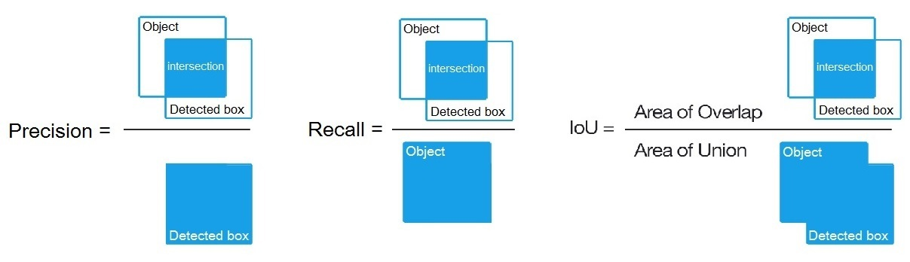
Mean Average Precision ( MAP )
In order to calculate mAP, we draw a series of precision-recall curves with the IoU threshold set at varying levels of difficulty. In COCO evaluation, the IoU threshold ranges from 0.5 to 0.95 with a step size of 0.05 represented as AP@[.5:.05:.95]

Slide 22
Mean Average Precision ( MAP )
• These precision and recall values are then plotted to get a PR (precision-recall) curve. The area under the PR curve is called Average Precision (AP).
• We draw these precision-recall curves for the dataset split out by class type (for example 3 classes and 6 threshold ranges).

Slide 23
Mean Average Precision ( MAP )
• For each class, calculate AP at different IoU thresholds and take their average to get the AP of that class.
• Calculate the final AP by averaging the AP over different classes.
mAP-IoU_thresholds
mAP - example COCO dataset

Slide 24
Train YOLOV5 On A Custom Dataset

Slide 25
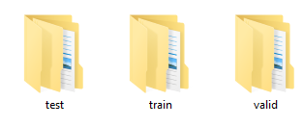
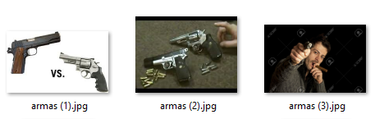
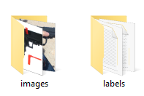
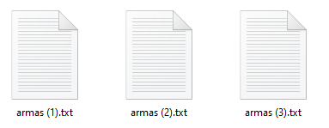
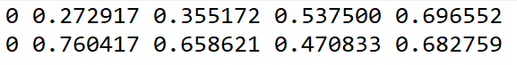
Train YOLOV5 On A Custom Dataset
My dataset
Train set
Train images
Train labels
label

Slide 26
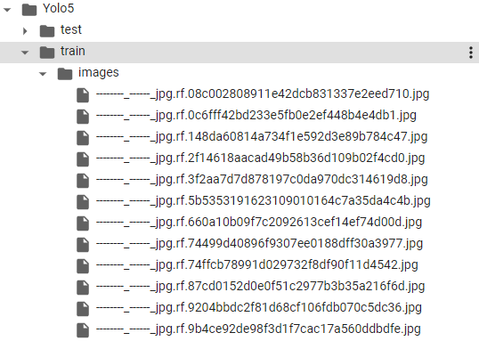
Custom Object Detection Data In YOLOV5 Format - Image

Slide 27
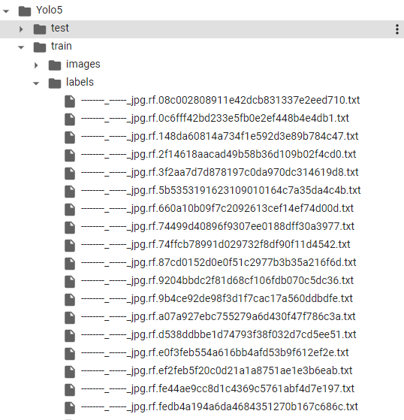
Custom Object Detection Data In Yolov5 Format - Label

Slide 28
Define Model Configuration And Architecture
We will write a new yaml script file (exp:coco128.ymal) defines the parameters for our model like the number of classes and the path of dataset and name of classes.
2) Copy then paste the script from one of the files (yolov5s, m, l, x) into your ymal script file (exp: yolov5s.ymal).

Slide 29
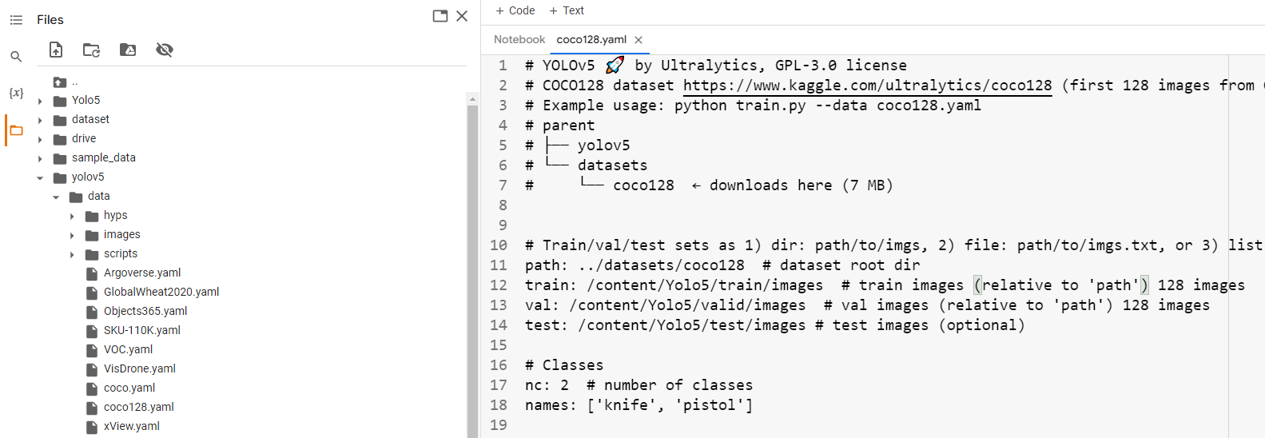
Custom Object Detection Data In Yolov5 Format – Coco128.yaml

Slide 30
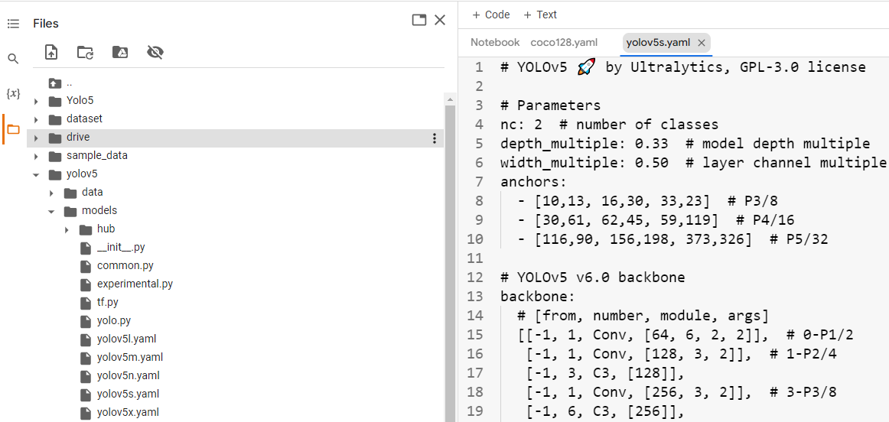
Custom Object Detection Data In Yolov5 Format – yolov5s.yaml

Slide 31
Yolov5 Training
• img: define input image size
• batch: determine batch size
• epochs: define the number of training epochs.
• data: set the path to our yaml file
• cfg: specify our model configuration
• weights: specify a custom path to weights.
• name: result names
• nosave: only save the final checkpoint
• cache: cache images for faster training

Slide 32
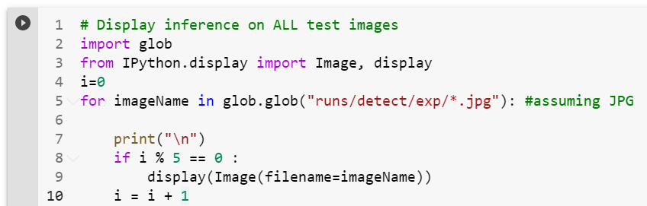
Yolov5 Detection

Slide 33
Train YOLOV6 On A Custom Dataset

Slide 34
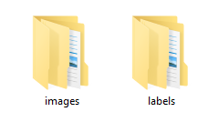
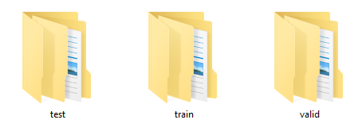
Train YOLOV6 On A Custom Dataset
My dataset
Train images
Train labels
label

Slide 35
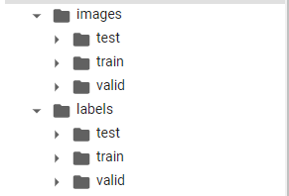
Custom Object Detection Data In YOLOV6 Format – Image and label

Slide 36
Define Model Configuration And Architecture
We will write a new yaml script file (exp:dataset.ymal) that defines the parameters for our model like the number of classes and the path of dataset and name of classes.
2) Create folder named weight and put weight on it.

Slide 37
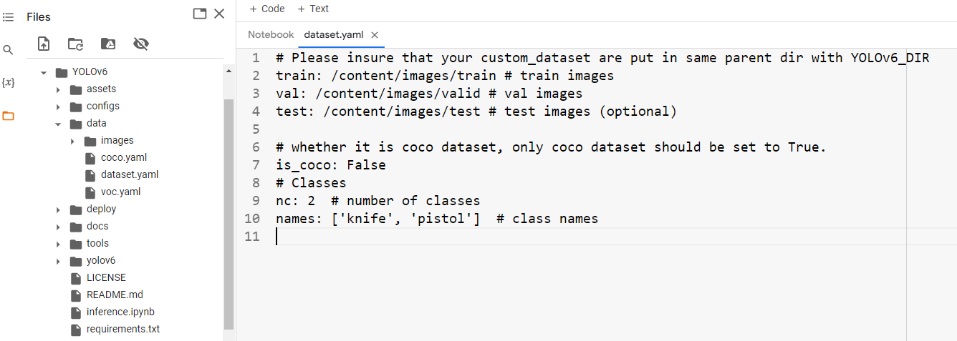
Custom Object Detection Data In Yolov6 Format – dataset.yaml

Slide 38
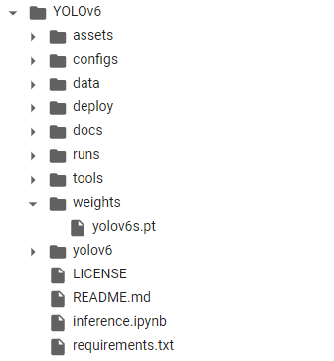
Custom Object Detection Data In Yolov6 Format – create folder and put weight

Slide 39
Yolov6 Training
• img: define input image size
• batch: determine batch size
• epochs: define the number of training epochs.
• data: set the path to our yaml file
• cfg: specify our model configuration
• weights: specify a custom path to weights.
• name: result names
• nosave: only save the final checkpoint
• cache: cache images for faster training

Slide 40
Yolov6 Detection

Slide 41
Train YOLOV7 On A Custom Dataset

Slide 42
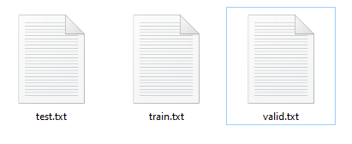
Train YOLOV7 On A Custom Dataset
My dataset
label
Train images
Train labels

Slide 43
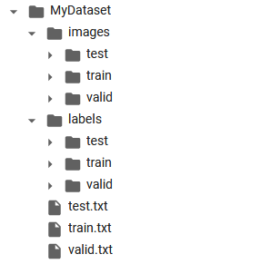
Custom Object Detection Data In YOLOV7 Format – Image and label

Slide 44
Define Model Configuration And Architecture
We will write a new yaml script file (exp:coco.ymal) that defines the parameters for our model like the number of classes and the path of dataset and name of classes.
We will write a new yaml script file (exp:yolov7.ymal) that defines the parameters for our model like the number of classes.

Slide 45
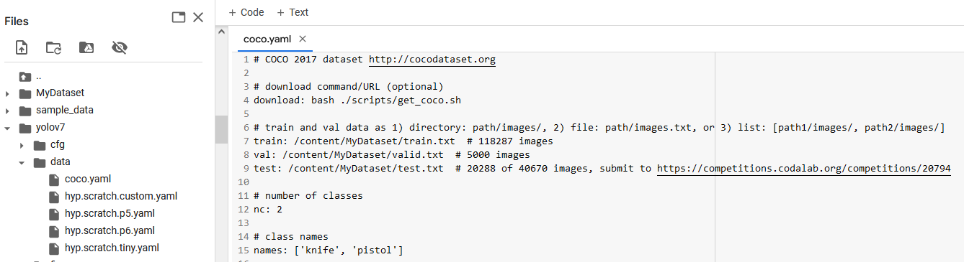
Custom Object Detection Data In Yolov7 Format – coco.yaml

Slide 46
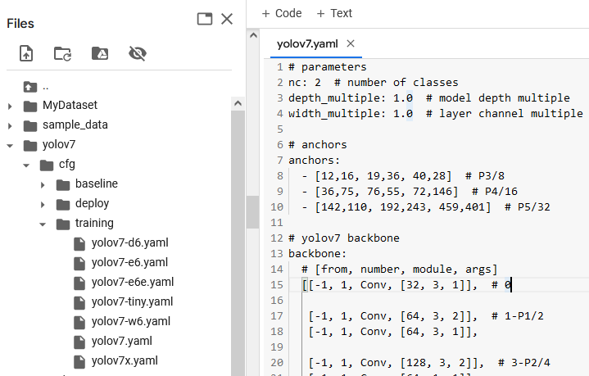
Custom Object Detection Data In Yolov7 Format – coco.yaml

Slide 47
Yolov7 Training
!python train.py --workers 8 --device 0
--batch-size 16 --epochs 25
--data data/coco.yaml --img 640 640
--cfg cfg/training/yolov7.yaml
--weights yolov7.pt --name yolov7
--hyp data/hyp.scratch.p5.yaml

Slide 48
Yolov7 Detection

Slide 49
Thanks for listening

